Slide 1
Unit 10
Understanding Taxes

Slide 2
Activity Fill out a sample 1040 tax form.

Slide 3
Preview the Topic What do you know about paying taxes?

Slide 4
Why Pay Taxes?
Taxes are paid to maintain a prosperous and functional society.

Slide 5
The Constitution
“Congress shall provide the Power to levy and collect Taxes, Duties, Imposts, and Excises to pay the Debts and provide for the common Defense and general Welfare of the United States.”

Slide 6
Federal and state taxes are deducted from your paycheck each month. You may get a refund if you overpaid!

Slide 7
How are Federal Taxes Used?
Infrastructure (roads, bridges, communication, sanitation, water, power)
Health care
Education
Defense
Social Security and Medicare

Slide 8
How Are State Taxes Used?
Education
Transportation
Fire Safety
Sanitation
Power
Parks and Recreation

Slide 9
How to file your taxes
The first step is to gather your documents such as the W-2 form.
The W-2 form reports your income and taxes deducted from your salary.
If you have investments, gather your 1099 forms that report interest earned.

Slide 10
Why Pay Taxes?

Slide 11
How Much Do We Pay in Taxes?
Taxation is progressive.
The lower your income, the less you pay.
The higher your income, the more you pay.

Slide 12
Tax owed is based on your taxable income
Your income – standard deduction ($12,550)= taxable income
You can itemize deductions if you have expenses over $12,550

Slide 13
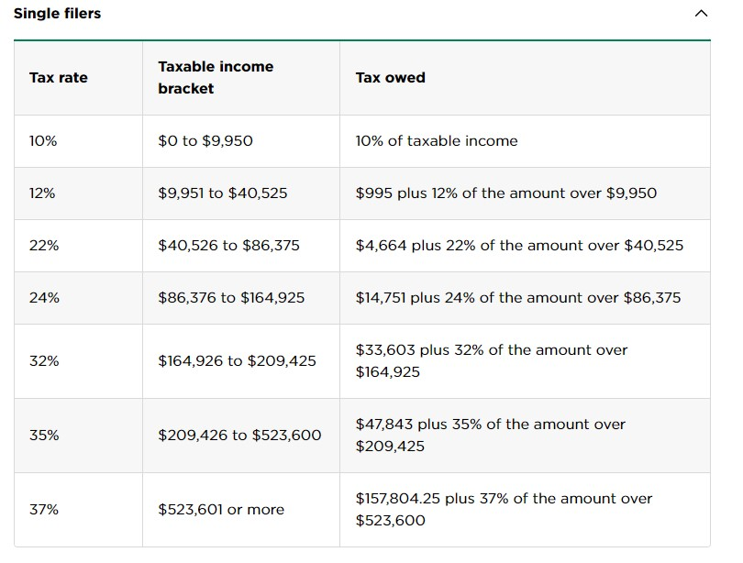

Slide 14
How to File Your Tax Return
If you earn money, you must file both a federal and state tax return.

Slide 15
How to Do Taxes for the First Time

Slide 16
Three Ways to File Your Taxes
Paper
Professional Tax Preparer
Electronic

Slide 17
Filing a Paper Tax Return
Download the form from irs.gov
Fill out the form and mail it to the IRS
Disadvantages
Processing is slow.
It is easy to make mistakes

Slide 18
Hire a Professional Tax Preparer
Best for complicated taxes (such as when you own a business)
Can be expensive

Slide 19
File Electronically
This option can be free or low cost if your income is low
Easy and accurate
Faster processing

Slide 20
Free Tax Software for Low Income Wage Earners
IRS Free File
TurboTax
Free Tax USA
TaxAct

Slide 21
Stand up if you agree. What is the best way to file your taxes? State the advantages of your choice.
Fill out a paper tax return and return it to the IRS.
01
Hire a professional tax preparer.
02
File your forms electronically using tax software.
03

Slide 22
How to Fill out Form 1040
Basic information about yourself
Information about your taxable income
How much tax do you owe?
Find out your refund amount or tax bill
Sign and date your form before you submit it

Slide 23
How to Fill Out Form 1040

Slide 24
Keep a copy of your tax return.
You will need this document to purchase a home or apply for credit.

