Slide 1
Hawaii and Pacific Islands College and Career Success

Slide 2
Agenda
Meet co-author, Kau’ionalani Meade
Build excitement for the coming semester.
Describe some unique features of the textbook.
Share some of my key ideas and strategies for working with students.
List some tips for success.
Helping students find meaning and happiness in life.
Some practical tasks
Providing feedback on the journal entries
Understanding the assessments

Slide 3
Chapters
Cultural Identity and Success
Understanding Motivation
Choosing Your Major
Managing Time and Money
Using Brain Science to Improve Memory
Using Brain Science to Improve Study Skills
Taking Notes, Writing, and Speaking
Test Taking
Thinking Positively about the Future

Slide 4
Flip the Classroom
Students complete the chapters before class.
Your job is to engage with students
Questions and answers
Interactive Exercises
Discussion

Slide 5
Resources
www.collegesuccess1.com
Training Notes
Instructor Manual
Exercises
Handouts
PowerPoint
Video Suggestions

Slide 6
Cultural Content for Hawai’i and the Pacific Islands
While the text is designed for Native students, all student who live in Hawai’i and the Pacific Islands can benefit from increasing knowledge and appreciation of the culture of the people where they live.

Slide 7
Taking Pride in Your Culture
This textbook is based on the premise that students are more successful if they take pride in themselves and their culture.
Having pride in yourself is the foundation for good self-esteem and the foundation for good mental health and success in life.

Slide 8
Success in Education
Taking pride in your culture is important because it serves as a foundation for learning.
You are more likely to be successful if you approach learning with an understanding of your self which includes a sense of belonging to your family and an understanding and appreciation of your culture.

Slide 9
Hawaiian Values
Values are passed down throughout the generations.
Aloha is the root of all other values that lead to success in life.
Aloha can be used to be successful in college and careers.

Slide 10
To have aloha is to know how to treat others with love and to show respect. It begins with loving yourself and spreading this love to others.
Hawaiians have aloha for the:
Land: ‘aina
Family: ‘ohana
People: kanaka
Culture: mo’omeheu

Slide 11
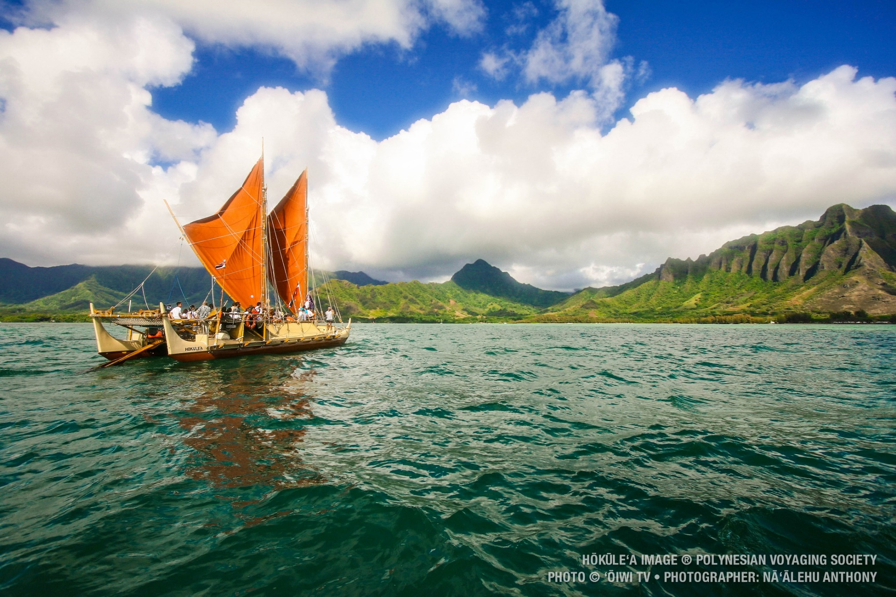
Revival of Pride in Hawaiian and Pacific Island Culture: The Hokule’a

Slide 12
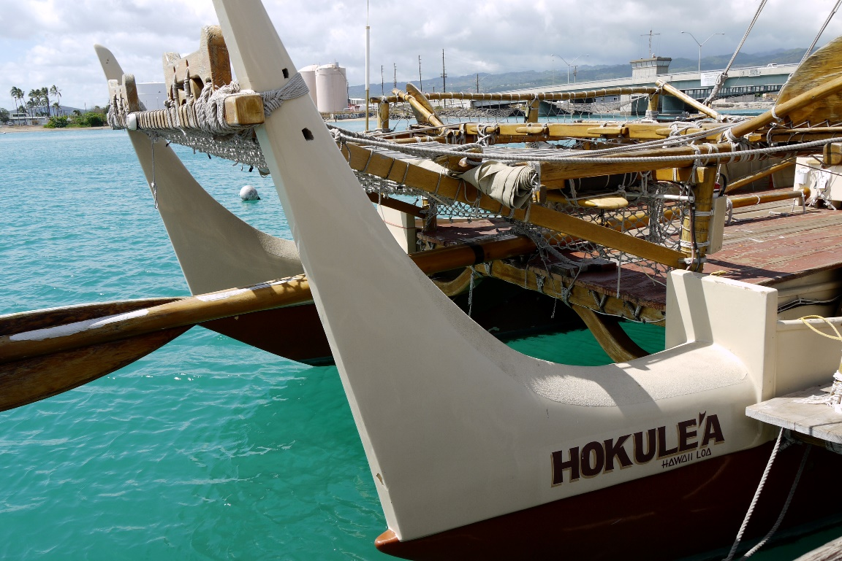
The Hokule’a
This project is helping students around the world take pride in their culture, inspiring beach clean-ups, school beautification, and discouraging pollution and littering.

Slide 13
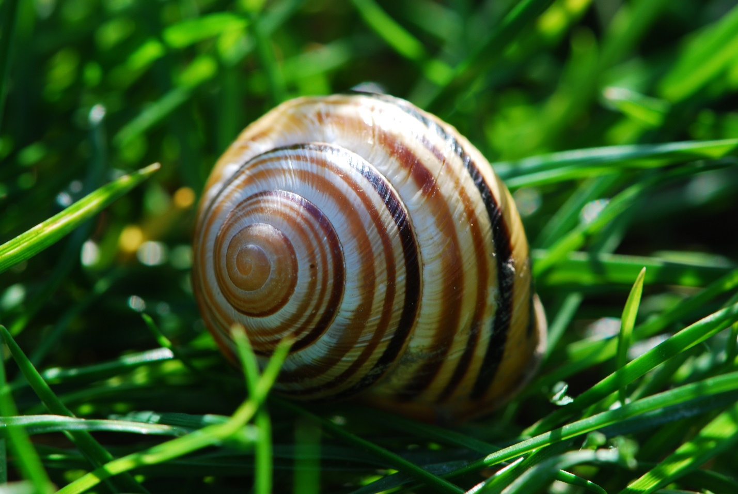
Appreciating Island Cultures: The Story of the Kahuli Shells
Read the story and discuss in class.

Slide 14
Cultural Wealth
What are some of your personal strengths from your family or community?
Write some ideas in the chat window or raise your hand.

Slide 15
Increase Motivation Help students understand their reason for attending college. What is your reason for attending college?
Write your answer in the chat window.

Slide 16
Career Emphasis
Career assessments help students to:
Focus on personal strengths
Connect them to a major and career
Students are empowered when they have a vision of the future, including their future career.
Important: Each personality type has different strengths. No personality type is better than any other.

Slide 17
Positive Psychology Provides the Foundation
Interacting with students
Providing feedback
Helping students understand their personal strengths using the career assessments.

Slide 18
What is Positive Psychology?
Happiness
Well-being
Flourishing (or thriving)
Personal strengths
Finding meaning in life

Slide 19
From Dr. Shamini Dias

Slide 20
Word Cloud Assignment

Slide 21
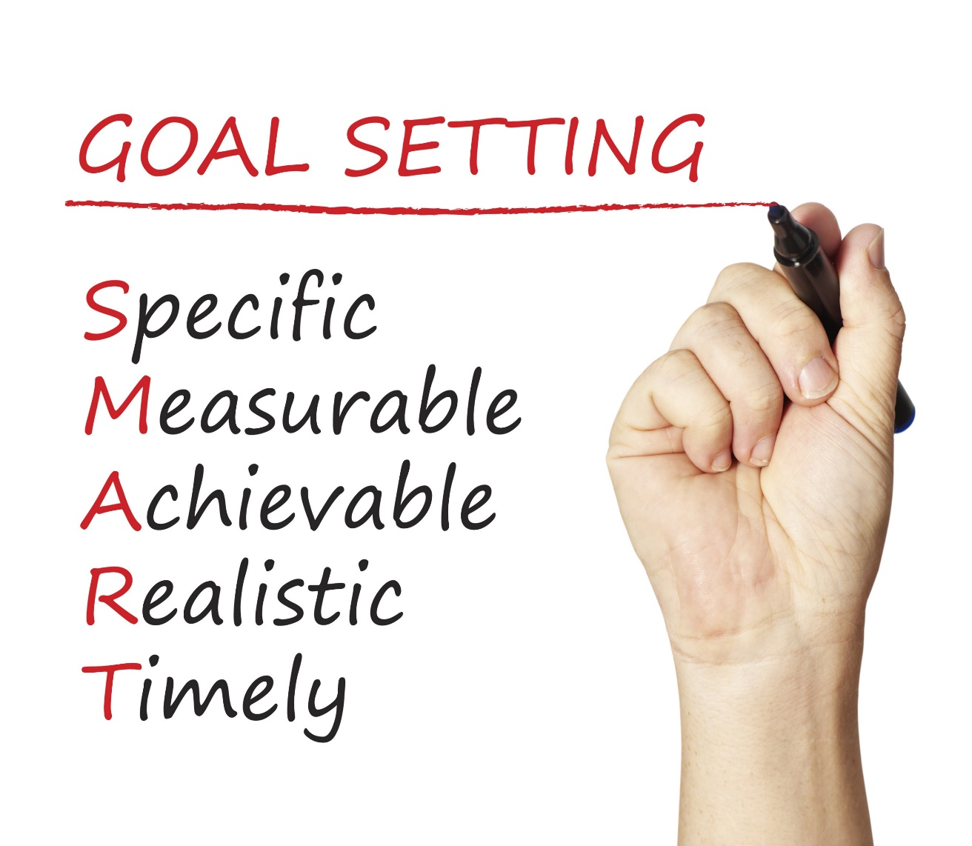
Happiness is a common goal.
How does it fit with SMART Goals?

Slide 22
Happiness is not a goal!
Achieving our goals is one of the ways to achieve happiness.

Slide 23
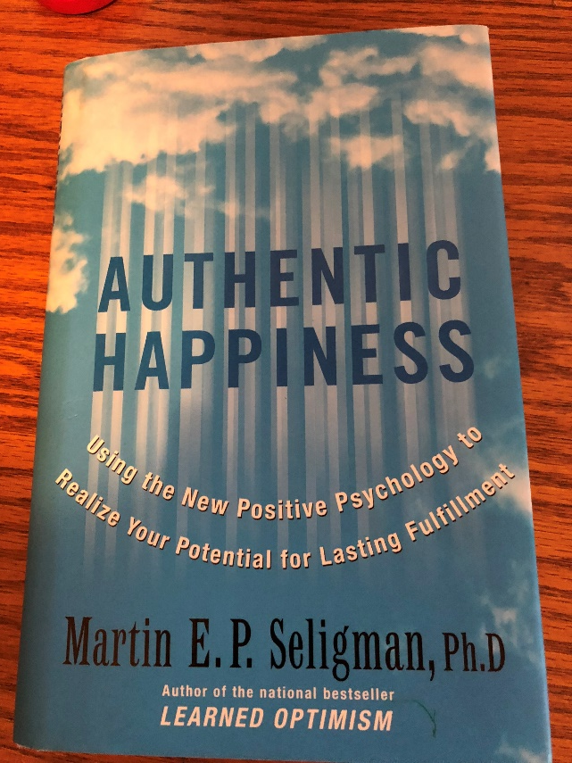
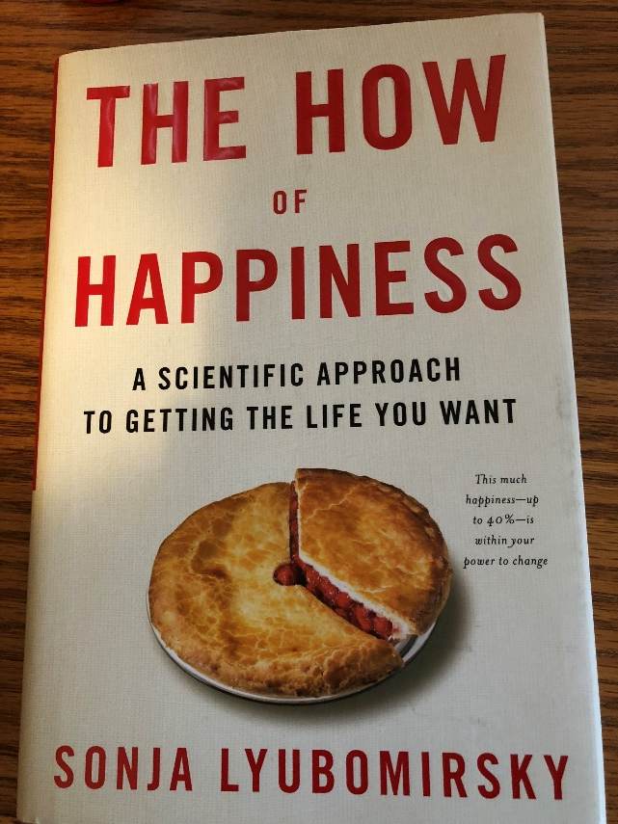
Martin Seligman Sonja Lyubomirsky
Positive psychologists who have done research on how to achieve happiness in your life. See the references on the handout.

Slide 24
Happiness or Hedonism?
Hedonist
The hedonist wants as many good moments and as few bad moments as possible.
Why doesn’t it work?
Hedonistic Adaptation
The more material possessions we have, the greater our expectations, and we no longer appreciate what we have.

Slide 25
The last chapter has ideas on how to achieve happiness.
Let’s Review:
Ways to Attain Happiness
Some practical exercises
Intention Statements

Slide 26
Express Gratitude
One of the most powerful happiness techniques
Notes:
Seth
The first activity is expressing gratitude. It is one of the most powerful happiness techniques.

Slide 27
Why Is Gratitude Important?
Savoring positive life experiences
Increasing self-esteem
Coping with stress and trauma
Encouraging moral behavior
You are more likely to help others
Building social bonds
Diminishing negative emotions
such as anger, bitterness, and greed
Appreciating what you have
Avoiding hedonistic adaptation.
Notes:
Marsha
Why is gratitude important?
Alternate reading boxes. Begin with Marsha.

Slide 28
Gratitude Exercise
What are 5 things in life for which you are grateful or thankful? Share your ideas.
Keep a gratitude journal. Each week list at least five things for which you’re grateful or simply take some time to contemplate why you are grateful.
Make it a Thanksgiving tradition.
Notes:
Marsha
Lead group in exercise
While participants are thinking, Marsha and Seth provide examples of being grateful for what we have in life.
Marsha:
I am grateful for my good health and my family.
Seth?

Slide 29
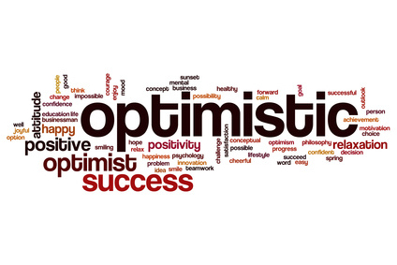
Cultivate Optimism
Notes:
Marsha
Another way to increase happiness is to cultivate optimism.

Slide 30
Cultivate optimism with mindset.

Slide 31
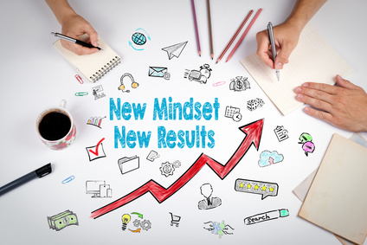
Positive Thinking and Mindset
Negative Thinking: Fixed Mindset
Positive Thinking: Growth Mindset
Intelligence is fixed at birth.
Increased effort does not lead to success.
Roadblocks are an excuse to be absent.
Intelligence is increased as you acquire new knowledge.
Through practice and effort, skills can be improved.
Failure is an opportunity to learn.
Notes:
Marsha
Here are just a few key ideas from the psychology of mindset:
Negative Thinking: Fixed Mindset
Seth
Positive Thinking: Growth Mindset

Slide 32
What Went Well Exercise for Students
Have students write down daily 3 good things that happened to them.
Write about one of the following:
Why did this good thing happen?
What does this mean to you?
How can you have more of this good thing in the future?

Slide 33
Avoid Overthinking and Social Comparison
“Overthinking is thinking too much, needlessly, passively, endlessly, and excessively pondering the meaning, causes, and consequences of your character, your feelings, and your problems.” – Sonja Lyubomirsky
Negative Consequences:
Increases sadness
Fosters negative thinking
Impairs the ability to solve problems
Decreases motivation
Interferes with concentration
Notes:
Seth
Read slide

Slide 34
Social Comparison
Social media results in comparison:
Noticing our friends, coworkers, family members, and even fictional characters
On social media, they are smarter, richer, healthier, funnier, or more attractive than we are
Dealing with overthinking and social comparison:
Become aware of the impacts of social media.
Yell stop!
Don’t sweat the small stuff.
Will it matter in a year? If so, begin taking small steps to resolve the issue.
Notes:
Marsha
Read slide

Slide 35
Practice Acts of Kindness
Why does it work?
View others more positively
Connect with others
Appreciate your own good fortune
Leads to positive social consequences
Feel good about yourself
Chain of kindness
Notes:
Seth
Another way to increase happiness is through random acts of kindness. Read slide.
(Provide examples on next slide.)

Slide 36
Kindness Exercise
Seligman states that this exercise is the “single most reliable momentary increase in well-being of any exercise he has tested.”
Practice an act of kindness.
Examples?
Notes:
Seth and Marsha provide examples while group thinks of examples to possibly add in the chat window.
Marsha
Letting a car in the line of traffic.
Pulling weeds in my neighbor’s yard.
Seth?
Ask audience for participation.

Slide 37
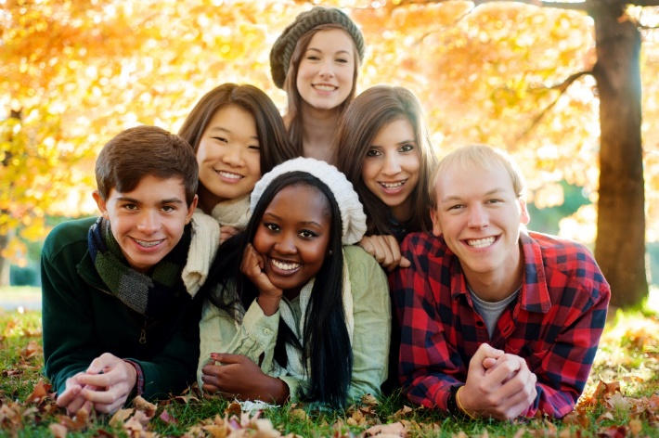
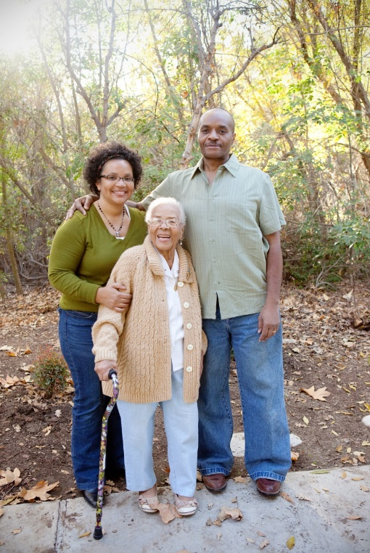
Nurture Social Relationships
Make time for others.
Express admiration and appreciation.
Be supportive and loyal.
Notes:
Marsha
Read slide and provide examples.
Marsha
Friends and museum
Seth add an example

Slide 38
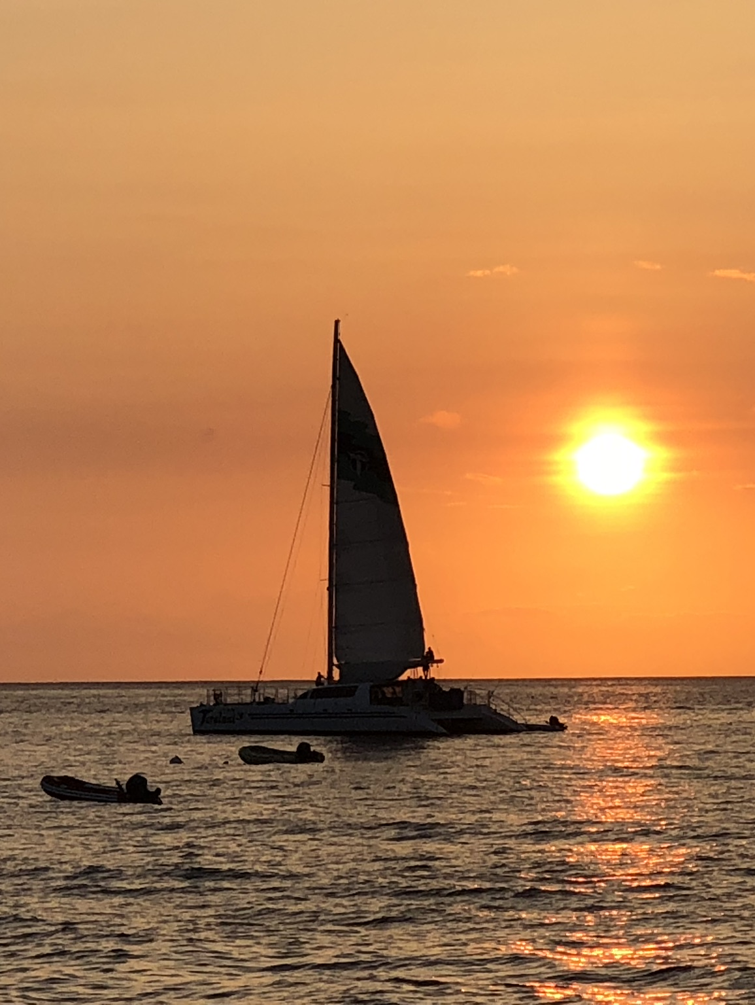
Develop Strategies for Coping
Meditation
Mindfulness
Breathing
Exercise
Sleep
We all know about these strategies. Can you increase some of them?
Notes:
Seth
Read Slide
(Examples next page)

Slide 39
What is mindfulness?
It is taking the time to notice your environment. It provides distraction from worry.
Examples?
Notes:
Marsha
This is my personal favorite idea. Examples of how I use it each day.

Slide 40
Grit is a powerful strategy for coping.
Grit = Passion and Perseverance

Slide 41
Grit: Key Ideas
Those who are gritty keep going after challenges or failure.
Grit is simply a “never give up” attitude.
What we accomplish may depend more on our passion and perseverance than our innate talent.
Talent is how quickly your skills improve when you invest effort.
Without effort, your talent is nothing more than your unmet potential.
Effortful training is more important than natural talent. It takes 10,000 hours to become an expert.
Those with a growth mindset are grittier.

Slide 42
Learn to Forgive
Notes:
Seth
Read slide

Slide 43
Increase Flow Activities
Flow is the state of intense absorption and involvement with the present moment.
Flow is one of the characteristics of the happy life.
The key to creating flow is to establish a balance between skills and challenges.
To maintain flow, we must test ourselves in challenging situations.

Slide 44
Flow and grit are related.
To increase grit (passion and perseverance):
Begin with interest
Next comes practice. Practice increases interest.
Then comes purpose. We become passionate when we are convinced that our work matters and has meaning.
Finally comes hope for a better future.

Slide 45
Savor Life’s Joys
The ability to savor positive experiences in life is one of the most important ingredients of happiness.
Relish ordinary experiences
Savor and reminisce with family and friends.
Transport yourself.
Replay happy days.
Celebrate good news.
Be open to beauty and excellence.
Be mindful.
Brainstorm: Life’s Joys
Notes:
Seth
Read Slide
Marsha and Seth
Provide examples
Ask for audience participation in brainstorming if time.

Slide 46
Commit to Your Goals
“An aim in life is the only fortune worth finding.” -Robert Louis Stevenson
“Find a happy person and you will find a project.” -Sonja Lyubomirsky
Working toward a goal is as important to well-being as it’s attainment.
Goals provide structure and meaning to our lives.
Goals help us to master our time.
Accomplish goals with grit.
Notes:
Seth
Read slide
Provide examples of goals. Marsha add goals.

Slide 47
Take Care of Your Body
Exercise increases self-esteem.
It provides opportunities for flow.
Learn the basics of good nutrition

Slide 48
Intention Statements
Express Gratitude
Cultivate Optimism
Avoid Over-thinking and Social Comparison
Practice Random Acts of Kindness
Nurture Social Relationships
Develop Coping Strategies
Learn to Forgive
Increase Flow Activities
Savor Life’s Joys
Commit to Your Goals
Take Care of Your Body
Make a list of at least five things you can do to improve your happiness.
Review these ideas.
Share some of your ideas
Notes:
Marsha
Introduce exercise.
While group participants are thinking:
Seth, what are some of your intention statements?
Marsha share intention statements also.
I intend to savor life’s joys at the end of each day.
I intend to take care of my body by learning more about nutrition.
I intend to increase flow activities.

Slide 49
Intention Statements
Make a list of at least five things you can do to improve your happiness.
Make a list of at least five ways you can help your students to improve their happiness. Review the above lists.

Slide 50
Tips for Success
Celebrate your culture and values.
Your ohana is the source of strength, support, identity, and confidence.
Be open to learn about other cultures.
Appreciate different perspectives.
Learn to network with other people.
Be an advocate for Malama, protecting and caring for the earth, to improve the lives and futures of all earth’s inhabitants.

Slide 51
Applying Positive Psychology
Grading the journal entries.
Understanding the career assessments.

Slide 52
Final Project: Vision Board

